Slide 1



Investigation Question
Evolving Minds
Lesson 11
What happens when a group of harpies gets separated?
Notes:
ALL CLASS – SLIDE 1
Tell students that they will see a new story that stars two populations of animals, harpies and juramayas, that look very different from each other.
The investigation question is: What happens when a group of harpies gets separated?

Slide 2
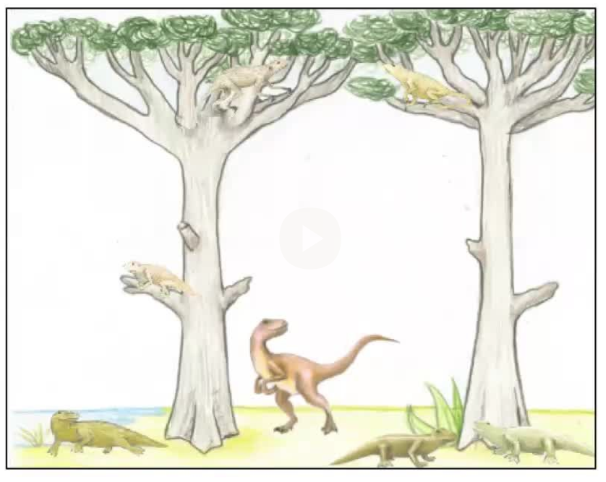
How the Harpies Evolved into Juramayas
Watch the first part
https://youtu.be/_xKNThYEmlM
Notes:
ALL CLASS – SLIDE 2
Play the animation How the Harpies Evolved into Juramayas until the video says "Pause here!” (around 2:40).

Slide 3
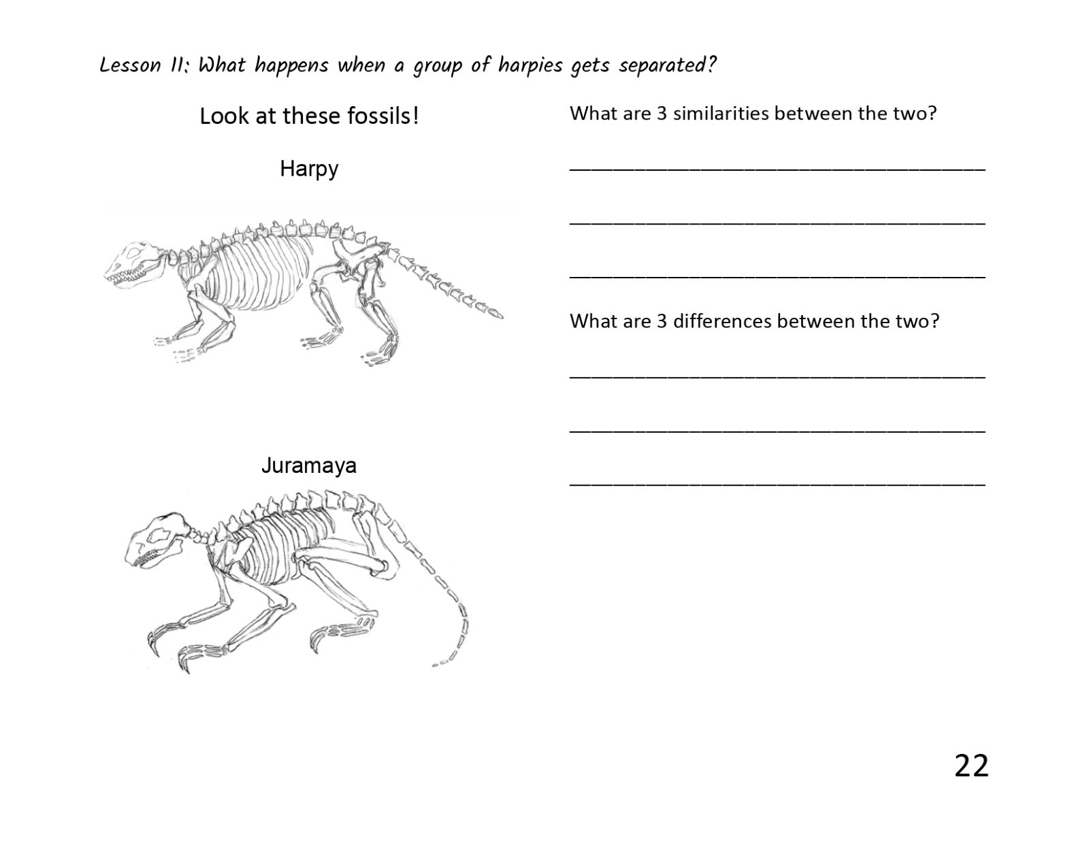
Turn to page 24 in your notebook!
Notes:
SMALL GROUPS – SLIDE 3
Have students move into their small groups and tell them to turn to page 24 in their notebooks where they will see reconstructed fossils of a harpy and a juramaya.
Explain that they are going to look at some of the same fossil evidence that the scientists looked at to piece together the history of the juramayas.
Their task is to examine the fossils and identify what is similar and what is different.
[What is similar? Sharp, pointy teeth, long spines, similar legs.
What is different? Juramaya has smaller tail bones, longer legs and feet bones, longer claws.]

Slide 4
Let’s find out what happens next….
https://youtu.be/_xKNThYEmlM?t=159
Notes:
ALL CLASS – SLIDE 4
Students can stay in their groups as you show the rest of the video.

Slide 5
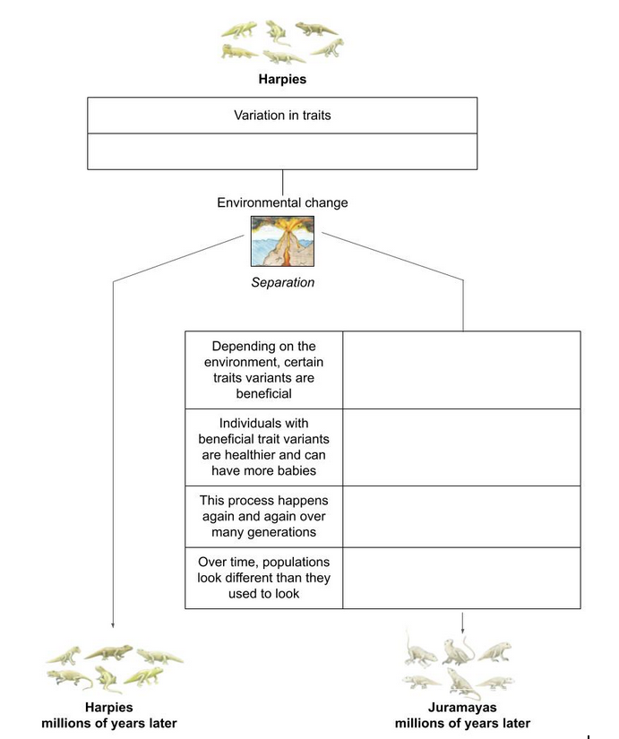
Turn to page 25 in your notebook!
Fill in the chart using evidence from the video!
Notes:
SMALL GROUPS – SLIDES 5-6
Ask students to open their notebooks to page 25.
Explain that their task is to use evidence from the video to fill out the 6 Key Steps of natural selection chart to explain how the juramayas evolved, just like they did as a class for the piloses, radishes, anoles, and miroungas

Slide 6
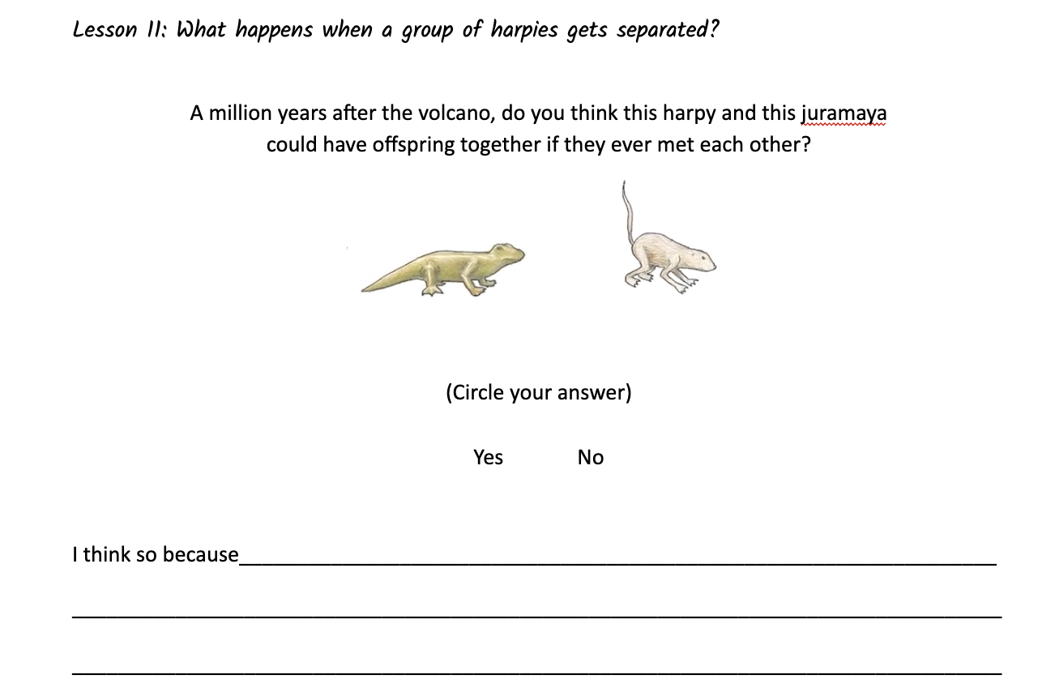
Turn to page 26 in your notebook!
Notes:
SMALL GROUPS – SLIDES 5-6
Ask students to open their notebooks to page 25.
Explain that their task is to use evidence from the video to fill out the 6 Key Steps of natural selection chart to explain how the juramayas evolved, just like they did as a class for the piloses, radishes, anoles, and miroungas

Slide 7
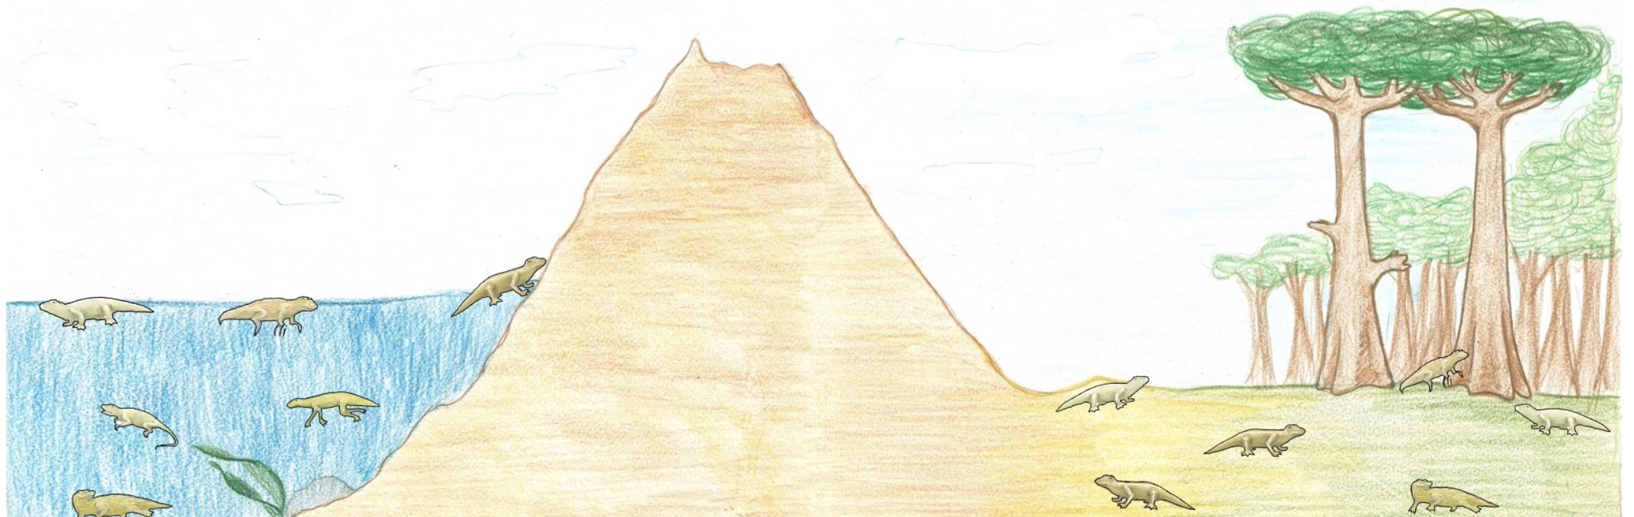
How did scientists decide that the two species are related?
What are the key steps that happen when a new species arises?
Is there a way to tell when two animals are from different species?
Notes:
ALL CLASS – SLIDE 7
The purpose of this discussion is for students to understand :
(i) how scientists use the fossil record to figure out that two very different species, the harpies and the juramayas, are related,
(ii) for a new species to arise, a part of the population needs to become isolated from the others,
(iii) in a speciation story, the same 6 Key Steps of natural selection happen, but it takes a longer time than in an adaptation story.
Ask students the following questions:
How did scientists decide that the two species are related?
What are the key steps that happen when a new species arises?
[Time permitting] Is there a way to tell when two animals are from different species? (Hint: their body stuff is different enough that they can’t have offspring together)

Slide 8

What ideas or information are you taking away from today’s lesson?
What should we write on the Takeaways Chart?
Notes:
ALL CLASS – SLIDE 8
Ask students to briefly summarize what they will “take away” from today’s lesson.
Listen for some of these ideas and record them on the Takeaways chart:
Scientists know that the two species are related because the fossils provided evidence.
A population that gets isolated can lead to a whole new species.
The 6 Key Steps happen in the isolated population over many, many, many generations.
Our question for the next lesson is: Can we imagine a natural selection story about the future of a “nowadays” animal population if it gets separated?

